Slide 1
Object-Oriented Software Engineering
Practical Software Development using UML and Java
Chapter 4:
Developing Requirements

Slide 2
4.1 Domain Analysis
The process by which a software engineer learns about the domain to better understand the problem:
  The domain is the general field of business or technology in which the clients will use the software
  A domain expert is a person who has a deep knowledge of the domain
Benefits of performing domain analysis:
  Faster development
  Better system
  Anticipation of extensions
© Lethbridge/Laganière 2012
Chapter 4: Developing requirements

Slide 3
Domain Analysis document
  Best put on a website (e.g. a Wiki) as descriptive test and diagrams with links to relevant information
  A. Quick summary
  B. Glossary
  C. General knowledge about the domain
  D. Customers and users
  E. The environment
  F. Tasks and procedures currently performed
  G. Competing software
  H. Similarities to other domains
© Lethbridge/Laganière 2012
Chapter 4: Developing requirements

Slide 4
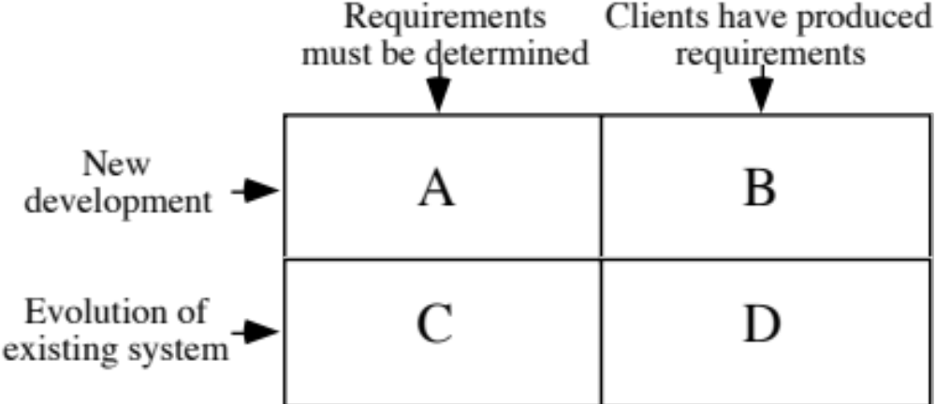
4.2 The Starting Point for Software Projects
green field project
© Lethbridge/Laganière 2012
Chapter 4: Developing requirements

Slide 5
4.3 Defining the Problem and the Scope
A problem can be expressed as:
  A difficulty the users or customers are facing,
  Or as an opportunity that will result in some benefit such as improved productivity or sales.
The solution to the problem normally will entail developing software
A good problem statement is short and succinct
© Lethbridge/Laganière 2012
Chapter 4: Developing requirements

Slide 6
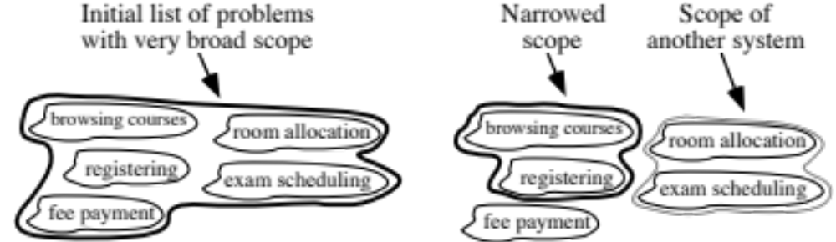
Defining the Scope
Narrow the scope by defining a more precise problem
  List all the things you might imagine the system doing
    Exclude some of these things if too broad
    Determine high-level goals if too narrow
Example: A university registration system
© Lethbridge/Laganière 2012
Chapter 4: Developing requirements

Slide 7
4.4 What is a Requirement ?
It is a statement describing either
  1) an aspect of what the proposed system must do,
  or 2) a constraint on the system’s development.
  In either case it must contribute in some way towards adequately solving the customer’s problem;
  the set of requirements as a whole represents a negotiated agreement among the stakeholders.
© Lethbridge/Laganière 2012
Chapter 4: Developing requirements

Slide 8
Anatomy of a Good User Requirement
Defines the system
under discussion
Identifies the system under discussion and a desired end result that is wanted within a specified time that is measurable
The challenge is to seek out the system under discussion, end result, and success measure in every requirement
Verb with correct identifier (shall or may)
The Online Banking System shall allow the Internet user
to access her current account balance in less than 5 seconds.
Defines a positive end result
Quality criteria

Slide 9
Example of a Bad User Requirement
Cannot write a requirement on the user
No identifier for the verb
X
The Internet User quickly sees her current
account balance on the laptop screen.
Vague quality criteria
What versus how

Slide 10
Standard for Writing a Requirement
Each requirement must first form a complete sentence
Each requirement contains a subject and predicate
  Subject: a user type (watch out!) or the system under discussion
  Predicate: a condition, action, or intended result
  Verb in predicate: “shall” / “will” / “must” to show mandatory nature; “may” / “should” to show optionality
The whole requirement provides the specifics of a desired end goal or result
Contains a success criterion or other measurable indication of the quality

Slide 11
Writing Pitfalls to Avoid
X
“What versus how” test
The system shall use Microsoft Outlook to send an
email to the customer with the purchase confirmation.
The system shall inform the customer
that the purchase is confirmed.

Slide 12
Writing Pitfalls to Avoid
Do not speculate
  There is no room for “wish lists” – general terms about things that somebody probably wants
  Danger signs: vague subject type and generalization words such as usually, generally, often, normally, typically
Do not express suggestions or possibilities
  Suggestions that are not explicitly stated as requirements are invariably ignored by developers
  Danger signs: may, might, should, ought, could, perhaps, probably

Slide 13
Writing Pitfalls to Avoid
Avoid wishful thinking
  Wishful thinking means asking for the impossible (e.g., 100% reliable, safe, handle all failures, fully upgradeable, run on all platforms)
X
The Easy Entry System may be fully adaptable to all
situations and often require no reconfiguration by the user.

Slide 14
Writing Pitfalls to Avoid
Do not use vague indefinable terms
  Many words used informally to indicate quality are too vague to be verified
  Danger signs: user-friendly, highly versatile, flexible, to the maximum extent, approximately, as much as possible, minimal impact
X
The EasyEntry System shall be easy to use and require
a minimum of training except for the professional mode.

Slide 15
Rate these Requirements
Martha can’t … Good & Bad Standard Pitfalls to Avoid A Few Simple Tests Summary & Tools
X
The Order Entry system provides for quick, user-
friendly and efficient entry and processing of all orders.
X
Invoices, acknowledgments, and shipping notices shall
be automatically faxed during the night, so customers
can get them first thing in the morning.
X
Changing report layouts, invoices, labels, and form
letters shall be accomplished.
X
The system shall be upgraded in one whack.
X
The system has a goal that as much of the IS data as
possible be pulled directly from the T&M estimate.

Slide 16
4.5 Types of Requirements
Functional requirements
  Describe what the system should do
Quality requirements
  Constraints on the design to meet specified levels of quality
Platform requirements
  Constraints on the environment and technology of the system
Process requirements
  Constraints on the project plan and development methods
© Lethbridge/Laganière 2012
Chapter 4: Developing requirements

Slide 17
Functional Requirements
  What inputs the system should accept
  What outputs the system should produce
  What data the system should store that other systems might use
  What computations the system should perform
  The timing and synchronization of the above
© Lethbridge/Laganière 2012
Chapter 4: Developing requirements

Slide 18
Quality Requirementts
All must be verifiable
Examples: Constraints on
  Response time
  Throughput
  Resource usage
  Reliability
  Availability
  Recovery from failure
  Allowances for maintainability and enhancement
  Allowances for reusability
© Lethbridge/Laganière 2012
Chapter 4: Developing requirements

Slide 19
Top hat Monocle Question
Types of requirements (best done using the web)
© Lethbridge/Laganière 2012
Chapter 4: Developing requirements

Slide 20
4.6 Use-Cases: describing how the user will use the system
A use case is a typical sequence of actions that a user performs in order to complete a given task
  The objective of use case analysis is to model the system from the point of view of
    … how users interact with this system
    … when trying to achieve their objectives.
    It is one of the key activities in requirements analysis
  A use case model consists of
    a set of use cases
    an optional description or diagram indicating how they are related
© Lethbridge/Laganière 2012
Chapter 4: Developing requirements

Slide 21
Use cases
A use case should
  Cover a sequence of steps
  Describe the user’s interaction with the system ...
    Not the computations the system performs.
  Be as independent as possible from any particular user interface design.
  Only include actions in which the actor interacts with the computer.
    Not actions a user does manually
© Lethbridge/Laganière 2012
Chapter 4: Developing requirements

Slide 22
How to describe a single use case
A. Name: Short and descriptive.
B. Actors: Types of users that will do this
C. Goals: What are the actors trying to achieve.
D. Preconditions: State of the system before the use case.
E. Summary: Short informal description.
F. Related use cases.
G. Steps: Describe each step using a 2-column format.
H. Postconditions: State of the system aftercompletion.
A and G are the most important
© Lethbridge/Laganière 2012
Chapter 4: Developing requirements

Slide 23
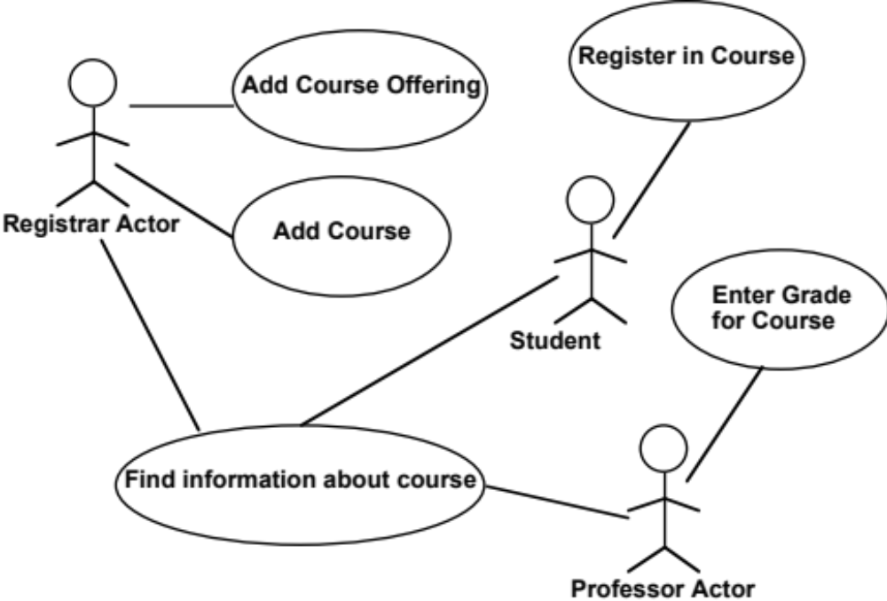
Use case diagrams
© Lethbridge/Laganière 2012
Chapter 4: Developing requirements

Slide 24
Extensions
  Used to make optional interactions explicit or to handle exceptional cases.
  Keep the description of the basic use case simple.
© Lethbridge/Laganière 2012
Chapter 4: Developing requirements

Slide 25
Generalizations
  Much like superclasses in a class diagram.
  A generalized use case represents several similar use cases.
  One or more specializations provides details of the similar use cases.
© Lethbridge/Laganière 2012
Chapter 4: Developing requirements

Slide 26
Inclusions
  Allow one to express commonality between several different use cases.
  Are included in other use cases
    Even very different use cases can share sequence of actions.
    Enable you to avoid repeating details in multiple use cases.
  Represent the performing of a lower-level task with a lower-level goal.
© Lethbridge/Laganière 2012
Chapter 4: Developing requirements

Slide 27
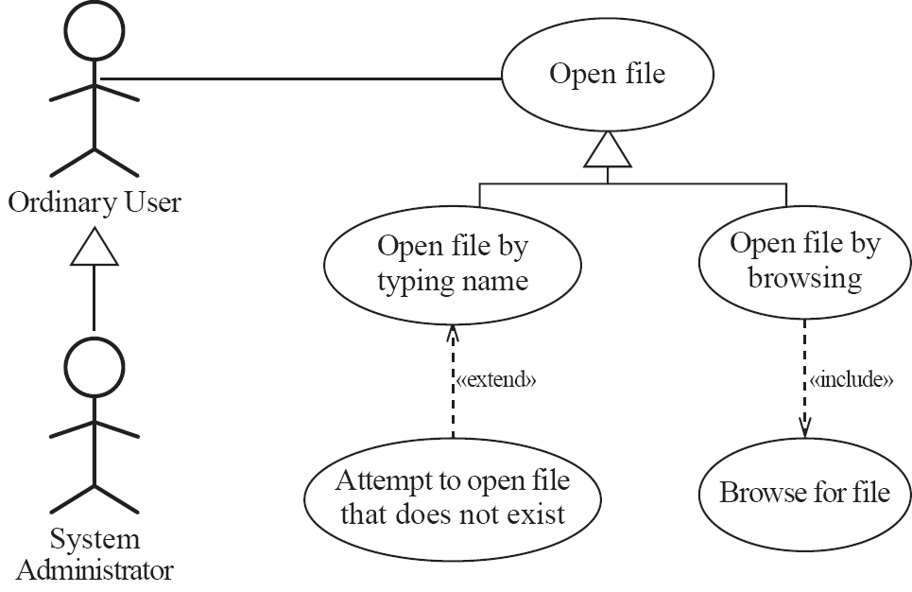
Example of generalization, extension and inclusion
© Lethbridge/Laganière 2012
Chapter 4: Developing requirements

Slide 28
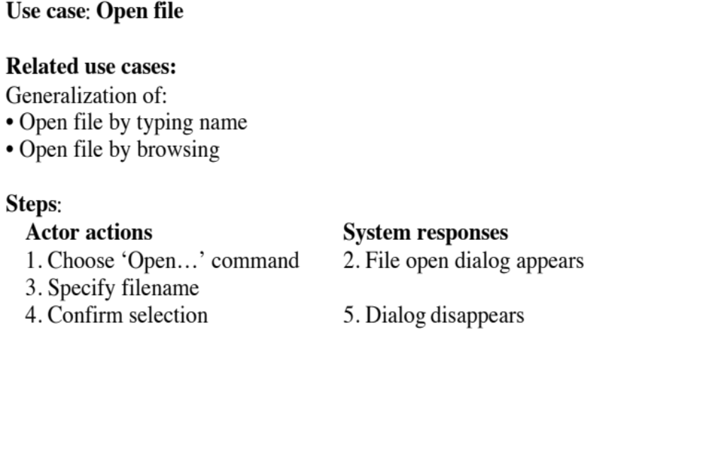
Example description of a use case
© Lethbridge/Laganière 2012
Chapter 4: Developing requirements

Slide 29
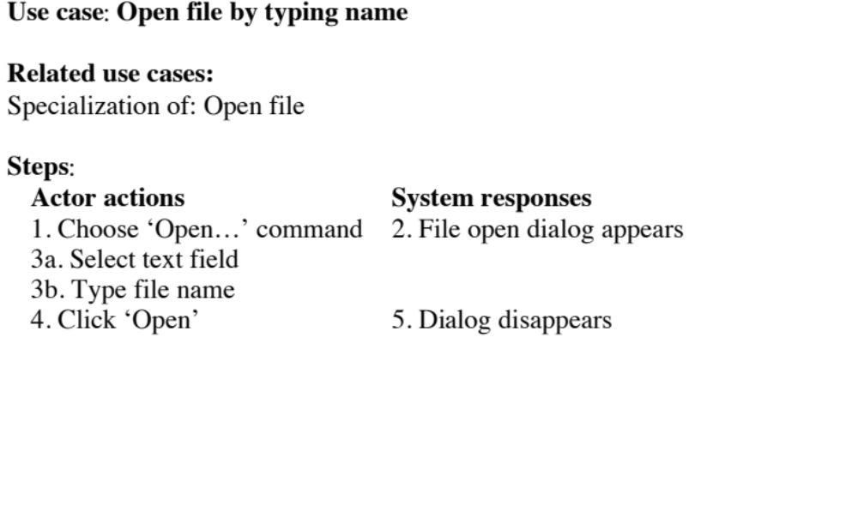
Example (continued)
© Lethbridge/Laganière 2012
Chapter 4: Developing requirements

Slide 30
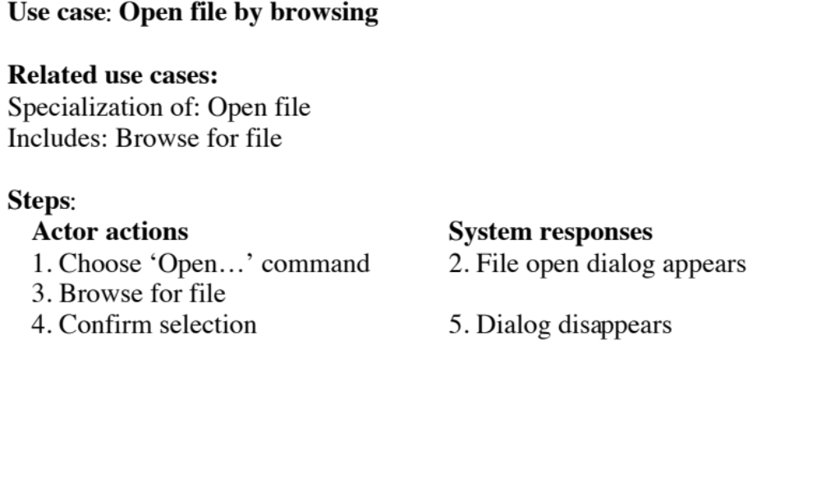
Example (continued)
© Lethbridge/Laganière 2012
Chapter 4: Developing requirements

Slide 31
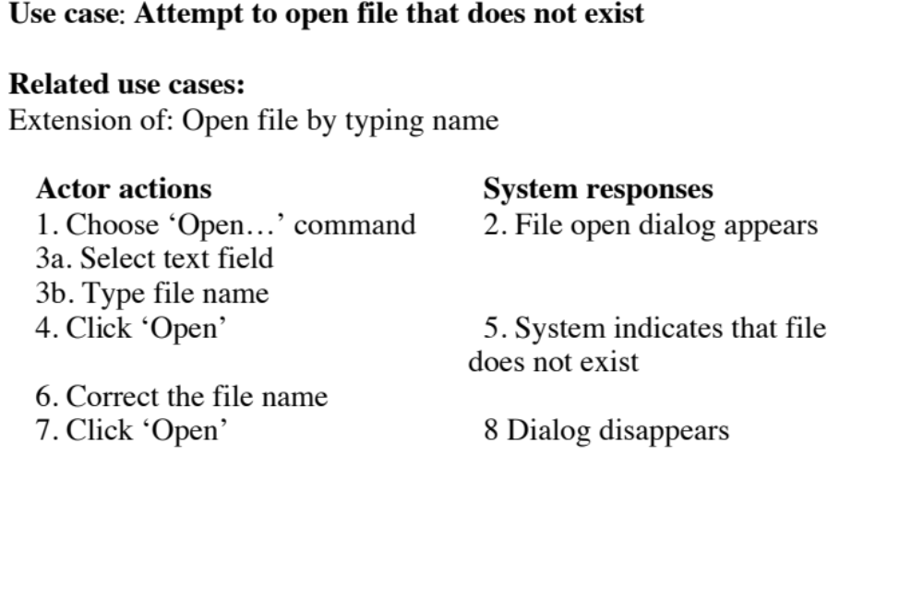
Example (continued)
© Lethbridge/Laganière 2012
Chapter 4: Developing requirements

Slide 32
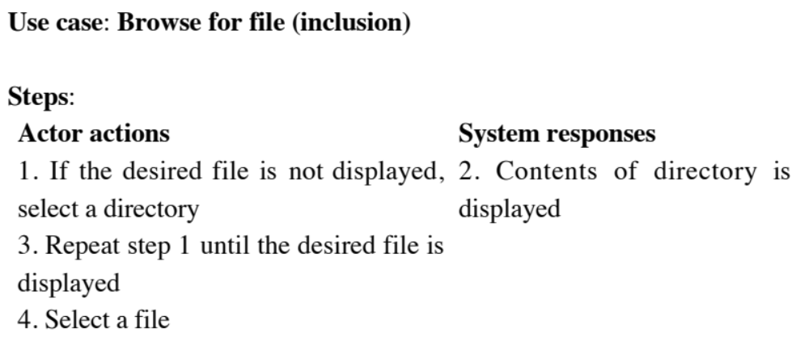
Example (continued)
© Lethbridge/Laganière 2012
Chapter 4: Developing requirements

Slide 33
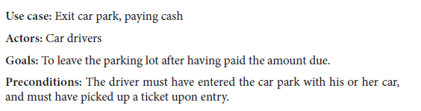
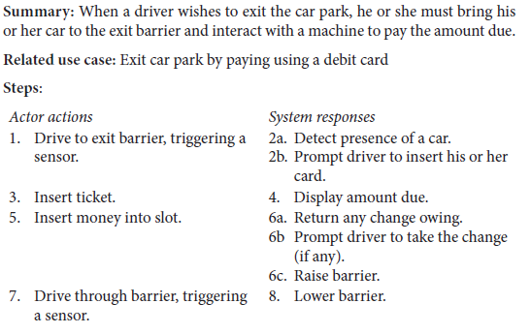
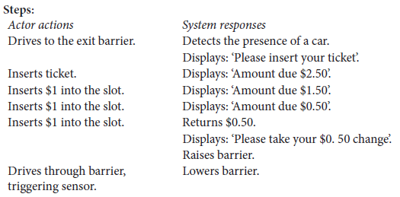
Use Cases vs Scenarios
A scenario is an instance of a use case that expresses a specific occurrence of the use case with a specific actor operating at a specific time and using specific data.
Scenario
© Lethbridge/Laganière 2012
Chapter 4: Developing requirements

Slide 34
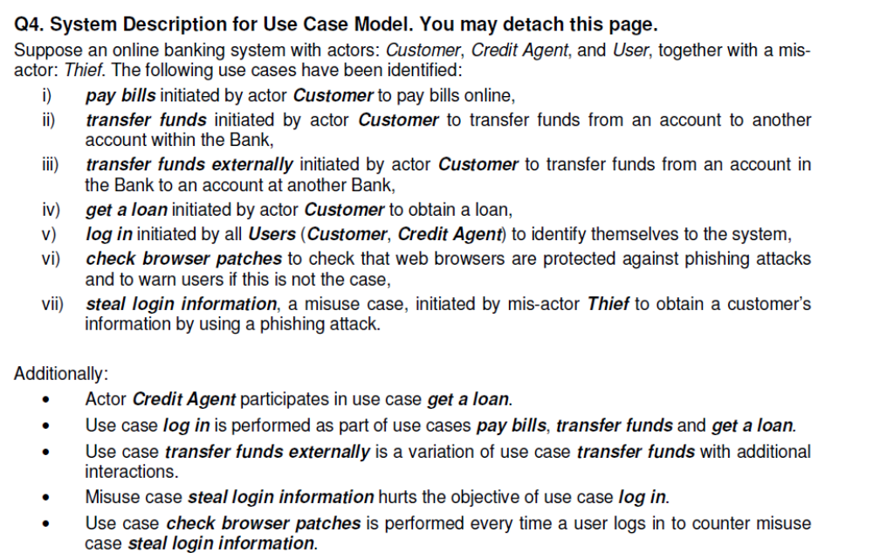

Another Example
© Lethbridge/Laganière 2012
Chapter 4: Developing requirements

Slide 35
Modeling: Choosing use cases on which to focus
  Often one use case (or a very small number) can be identified as central to the system
    The entire system can be built around this particular use case
  There are other reasons for focusing on particular use cases:
    Some use cases will represent a high risk because for some reason their implementation is problematic
    Some use cases will have high political or commercial value
© Lethbridge/Laganière 2012
Chapter 4: Developing requirements

Slide 36
The benefits of basing software development on use cases
Use cases can
  Help to define the scope of the system
  Be used to plan the development process
  Be used to both develop and validate the requirements
  Form the basis for the definition of test cases
  Be used to structure user manuals
© Lethbridge/Laganière 2012
Chapter 4: Developing requirements

Slide 37
User stories vs. use cases
The term ‘user stories’ is used in agile development
  Conceptually very similar to use cases
  Typically less formal
© Lethbridge/Laganière 2012
Chapter 4: Developing requirements

Slide 38
4.7 Techniques for Gathering and Analysing Requirements
Observation
  Read documents and discuss requirements with users
  Shadowing important potential users as they do their work
    ask the user to explain everything he or she is doing
  Session videotaping
Interviewing
  Conduct a series of interviews
    Ask about specific details
    Ask about the stakeholder’s vision for the future
    Ask if they have alternative ideas
    Ask for other sources of information
    Ask them to draw diagrams
© Lethbridge/Laganière 2012
Chapter 4: Developing requirements

Slide 39
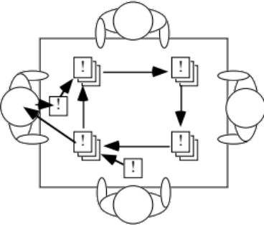
Gathering and Analysing Requirements...
Brainstorming
  Appoint an experienced moderator
  Arrange the attendees around a table
  Decide on a ‘trigger question’
  Ask each participant to write an answer and pass the paper to its neighbour
Joint Application Development (JAD) is a technique based on intensive brainstorming sessions
© Lethbridge/Laganière 2012
Chapter 4: Developing requirements

Slide 40
Gathering and Analysing Requirements...
Prototyping
  The simplest kind: paper prototype.
    a set of pictures of the system that are shown to users in sequence to explain what would happen
  The most common: a mock-up of the system’s UI
    Written in a rapid prototyping language
    Does not normally perform any computations, access any databases or interact with any other systems
    May prototype a particular aspect of the system
© Lethbridge/Laganière 2012
Chapter 4: Developing requirements

Slide 41
Gathering and Analysing Requirements...
Use case analysis
  Determine the classes of users that will use the facilities of this system (actors)
  Determine the tasks that each actor will need to do with the system
© Lethbridge/Laganière 2012
Chapter 4: Developing requirements

Slide 42
Level of detail required in requirements
  More detailed requirements are likely needed when
    The system is large and complex
    There is a need to interface to hardware or other systems
    Clients and users are in a very technical domain
      Engineering, science, financial analysis, etc.
    There could be large costs, safety issues or security issues if the requirements are faulty
© Lethbridge/Laganière 2012
Chapter 4: Developing requirements

Slide 43
Top Hat Monocle Question
How often to perform the requirements techniques
© Lethbridge/Laganière 2012
Chapter 4: Developing requirements

Slide 44
4.9 Reviewing Requirements
  Each individual requirement should
    Have benefits that outweigh the costs of development
    Be important for the solution of the current problem
    Be expressed using a clear and consistent notation
    Be unambiguous
    Be logically consistent
    Lead to a system of sufficient quality
    Be realistic with available resources
    Be verifiable
    Be uniquely identifiable
    Does not over-constrain the design of the system
© Lethbridge/Laganière 2012
Chapter 4: Developing requirements

Slide 45
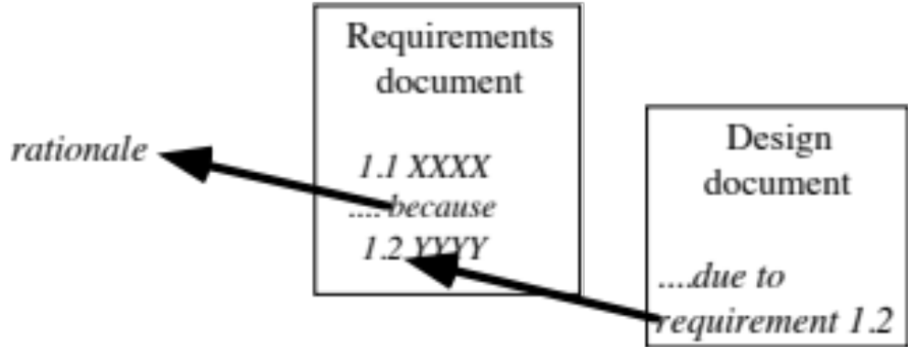
Key qualities of requirements
  The requirements should be:
    sufficiently complete
    well organized
    clear
    agreed to by all the stakeholders
  Traceability:
© Lethbridge/Laganière 2012
Chapter 4: Developing requirements

Slide 46
Example requirements:
GANA – p156
SimpleChat – p160
© Lethbridge/Laganière 2012
Chapter 4: Developing requirements

Slide 47
Sample problems with requirements: P154
Simple interest calculation program. This is a handy utility for users who are considering borrowing or lending money. A window pops up when the program starts. This has three fields entitled: ‘Principal:’, ‘Annual interest rate:’ and ‘Monthly interest payment:’. Whenever the user edits one of the fields the other two fields are automatically computed.
© Lethbridge/Laganière 2012
Chapter 4: Developing requirements

Slide 48
4.10 Managing Changing Requirements
Requirements change because:
  Business process changes
  Technology changes
  The problem becomes better understood
Requirements analysis never stops
  Continue to interact with the clients and users
  The benefits of changes must outweigh the costs.
    Certain small changes (e.g. look and feel of the UI) are usually quick and easy to make at relatively little cost.
    Larger-scale changes have to be carefully assessed
      Forcing unexpected changes into a partially built system will probably result in a poor design and late delivery
  Some changes are enhancements in disguise
    Avoid making the system bigger, only make it better
© Lethbridge/Laganière 2012
Chapter 4: Developing requirements

